Slide 1

GEN AI

Slide 2
Making machines perform tasks that normally require human intelligence
Reasoning
Learning
Problem Solving
Perception
Language Understanding

Slide 3
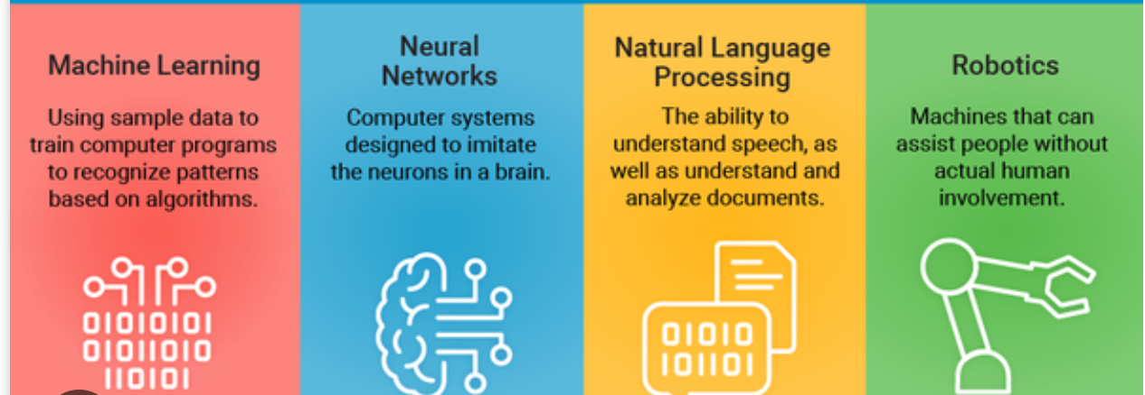
AI earlier: Automation, prediction and decision making

Slide 4
Applications
Rule Based Systems: If then rules for diagnosis, chess playing, fraud detection
Search and optimization: Path finding in maps, game algorithms
Classical Machine Learning: Spam filters, recommendation engines, stock price prediction

Slide 5
Gen AI: can generate new content
Creates new content: text, images, code, by learning patterns from existing data, mimicking human creativity
Create essays, paintings, songs etc

Slide 6
Model
It's a massive, complex program that has been trained on an enormous amount of data (text, images, etc.). This training allows the model to learn patterns, grammar, facts, and styles. The result is a highly trained brain that can take a command and generate an intelligent response.
The model is like a human brain that has read millions of books and seen countless images. It's not just a collection of facts; it understands the relationships and patterns between them.

Slide 7
LLM: Large Language Models
Type of AI model designed to understand and generate human-like text
It's "large" because it has been trained on a massive amount of text data from the internet, books, and other sources, allowing it to learn the patterns, grammar, and nuances of language.
Understands Context: LLMs can process and understand the context of a conversation or a document. They don't just match keywords; they grasp the meaning behind sentences.
Generative: They can create new, original content, such as answering questions, writing essays, summarizing articles, or even generating code.
Highly sophisticated autocomplete system. When you give it a prompt, it predicts the next most likely word, and then the next, and so on, building a complete and coherent response. Its training on vast data sets is what makes these predictions so accurate and intelligent.

Slide 8
LLaMA
Large Language Model Meta AI
Created by Meta (formerly Facebook)
It is a well-known example of a large language model (LLM), which is a type of GenAI model specifically designed to work with text.
Open-source, meaning it's freely available for researchers and developers to use and build upon.

Slide 9
Image Generation Models: trained on vast collections of images and their descriptions to create new pictures from text prompts.
DALL-E: Also from OpenAI, this model can generate incredibly imaginative and realistic images based on a user's text description. It's known for its creativity and ability to create surreal concepts.
Midjourney: This is a powerful, proprietary AI model that specializes in creating high-quality, artistic images. It has a distinctive visual style and is often used by artists and designers.
Stable Diffusion: An open-source model that has become very popular. Because it's open, developers and hobbyists can run it on their own hardware and customize it, making it a favorite for experimentation.

Slide 10
Prompt Engineering
Art and science of writing good instructions to get the best possible output from a model
The way you phrase your request can dramatically change the result.
A good prompt is specific, provides context, and often includes examples.
Prompt engineering is like giving detailed directions to a chef. Instead of saying, "Make me a sandwich," you would say, "Make me a gourmet Italian sub on ciabatta bread with provolone, salami, and roasted red peppers. Do not use mustard, and please toast it lightly." The more specific you are, the better the final "product" will be.

